Slide 1
Functional Genomics Meeting
Anamika
24.03.25

Slide 2
Experimental Design:
Optimized siRNA transfection for Knock down
Control
50 pmole
HHIP
50 pmole
Scratch
Control
HHIP siRNA knockdown conditions at 48hrs, 72 hrs;
48hrs
Control
50 pmole
HHIP
50 pmole
Scratch
+
GANT61
10uM
2. Scratch assay: Comparing at 0hrs, 24hrs, 29 hrs between
control and Gli inhibitor, GANT61 (10uM); take pictures;
distance measurement
72hrs
A549 cell lines

Slide 3
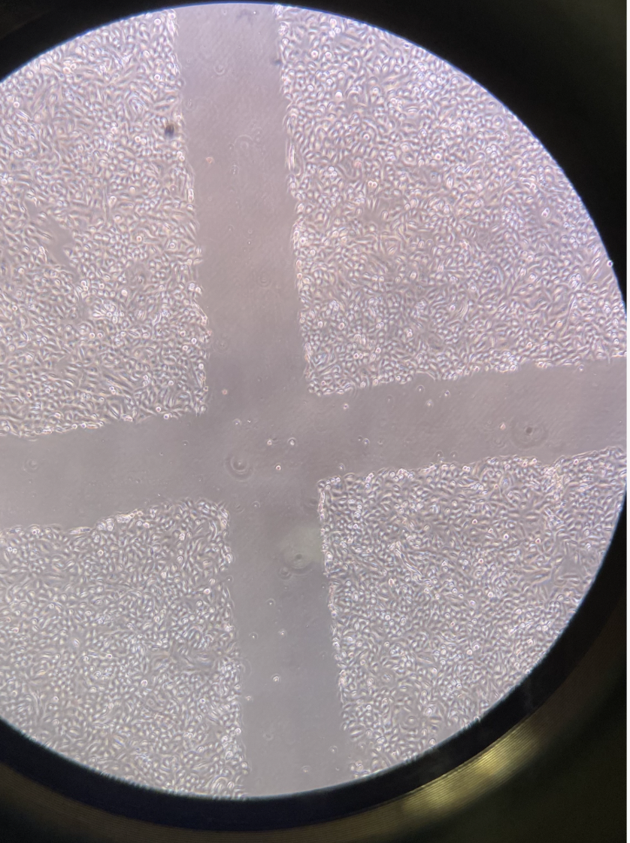
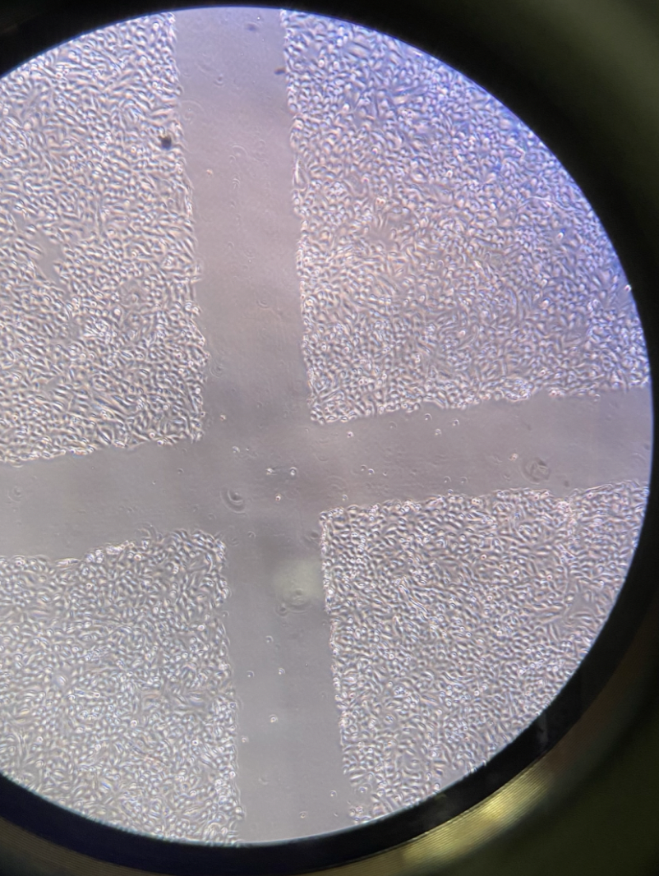
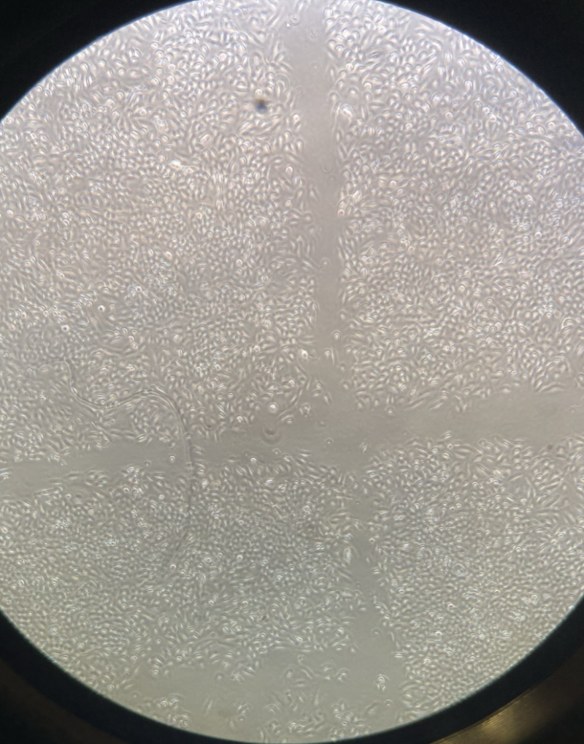
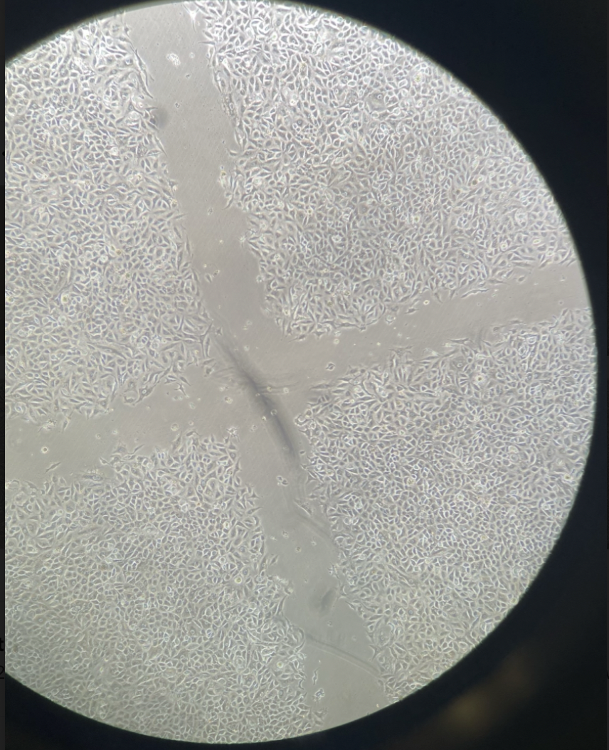
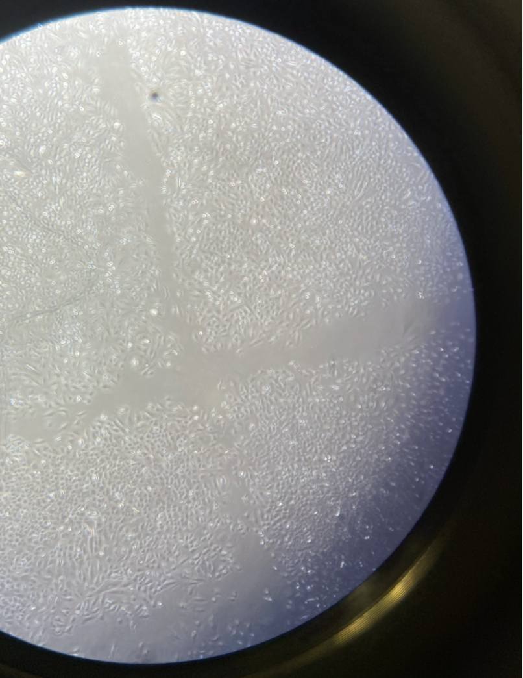
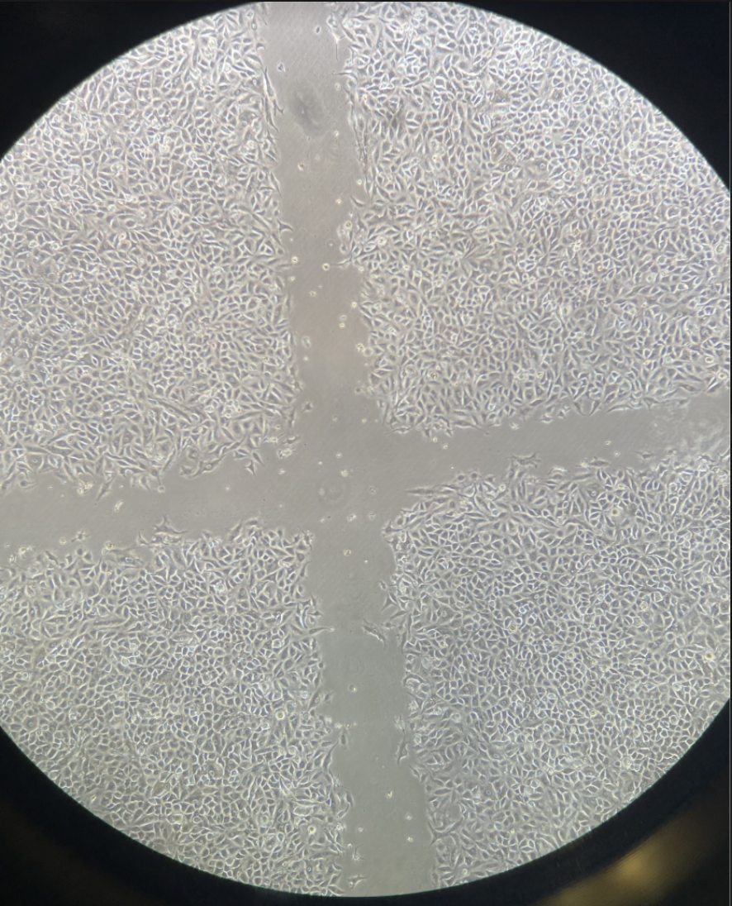
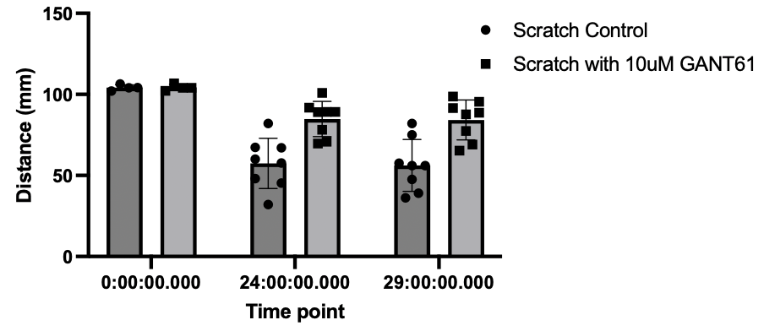
Scratch assay followed by GANT61 (10uM) treatment
0 hrs Scratch
24 hrs Scratch
29 hrs Scratch
Control
10uM GANT61
Control
10uM GANT61
Control
10uM GANT61
***
***
0hrs
24hrs
29hrs

Slide 4
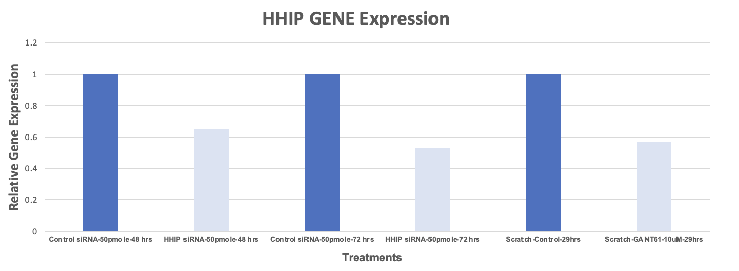
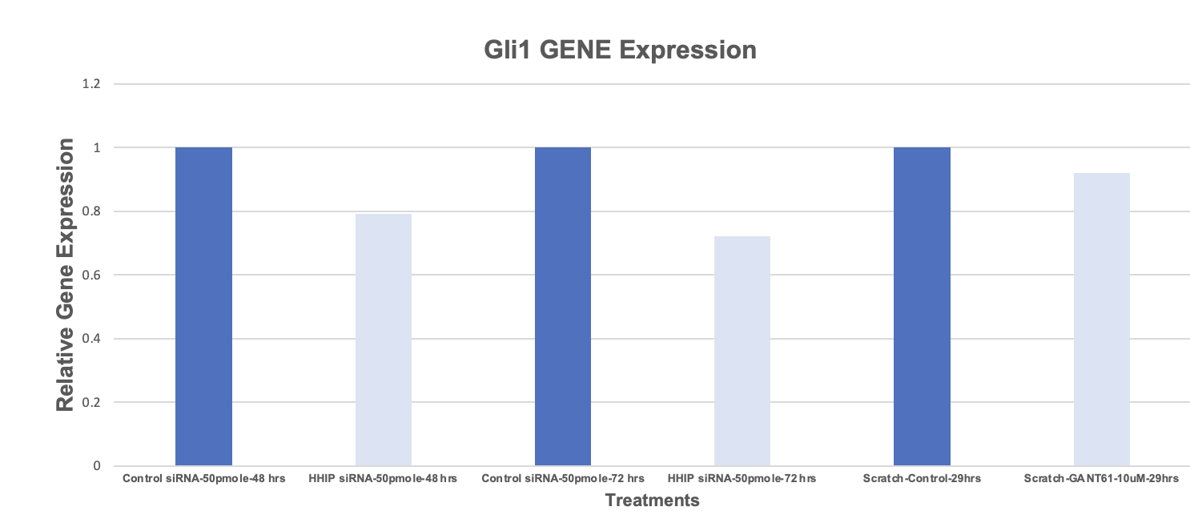
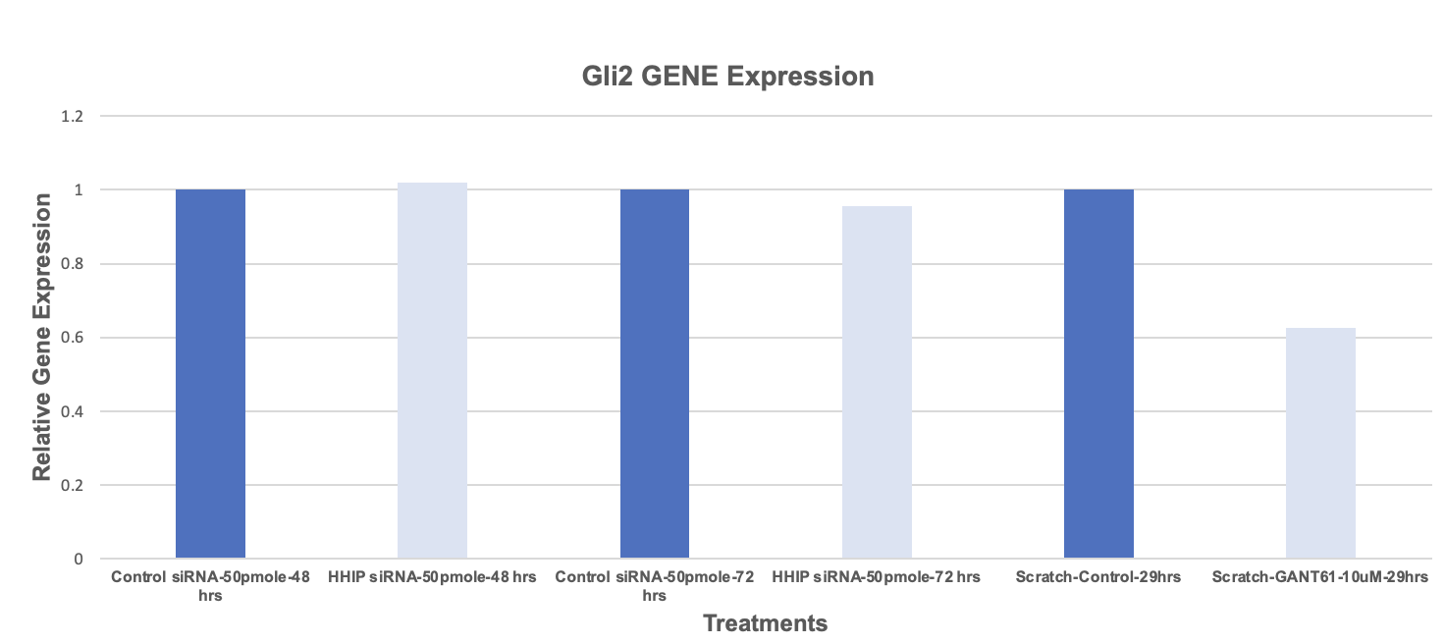
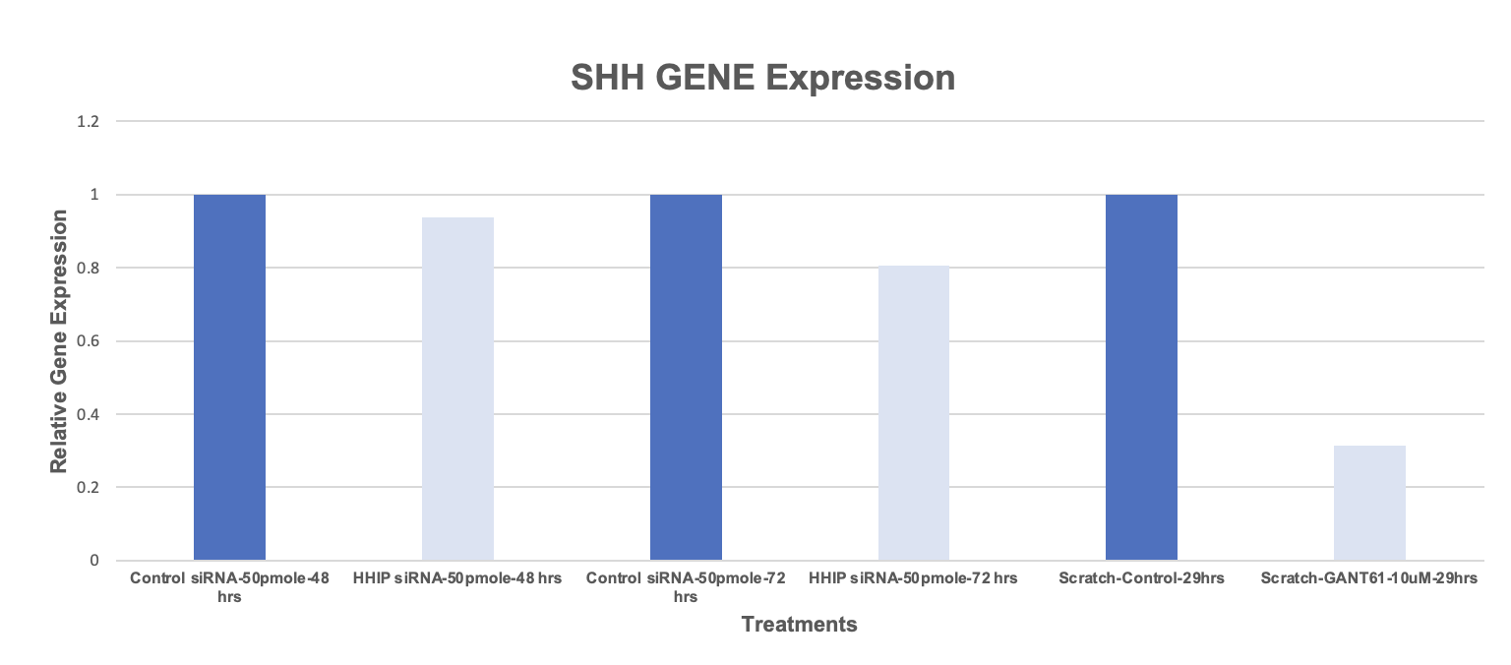
Relative Gene Expression of HHIP, Gli1, Gli2 and SHH in A549 cells

Slide 5
Scratch
+
GANT61 (10uM)
Scratch
+
SAG (50nM)
Scratch
+
Vismodegib (10uM)
Scratch
Control
Control siRNA
50 pmole
HHIP siRNA
50 pmole
A549 cell lines
A549 cell lines
Day 1: Seed Cells in 6 well plate
Day 2: siRNA transfection
Day3: Scratch + inhibitors treatment
Day4: Pictures

